Slide 1
TOPSI 2.0
The future of SOK stores’ and chains applicastions
Capgemini
xx^{th} August 2015

Slide 2
Why this approach?
Application lifecycle management
One cross functional team
Critical success factors
References

Slide 3
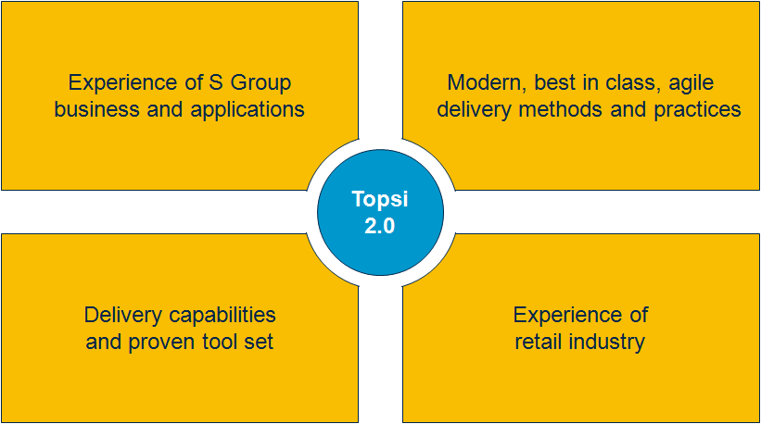
This document describes Capgemini’s vision of the future state of managing SOK’s business critical applications
We have created a concrete vision of the Topsi future state application management solution.
Our approach and solution is built on…
Our wide experience of S Group business and applications
Our deep understanding of modern, best in class, agile application development, application management and application operations delivery methods and practices
Our delivery capabilities and proven tool set
Our experiences of similar services in retail industry.

Slide 4
Efficiently managed application lifecycle requires one seamless and agile pipeline from business to operations
Our solution removes the borderlines between application development and application operations thus bringing true agility to the whole pipeline end-to-end.
Business
Development
Testing
Operations
Topsi 2.0 Application Lifecycle
Continuous Integration – Continuous Delivery
Agile Development – Automated Testing – Automated Deployment – Scalable Infrastructure
This approach brings unbeatable benefits but requires a major mindset change
and transformation from several silos to one pipeline.

Slide 5

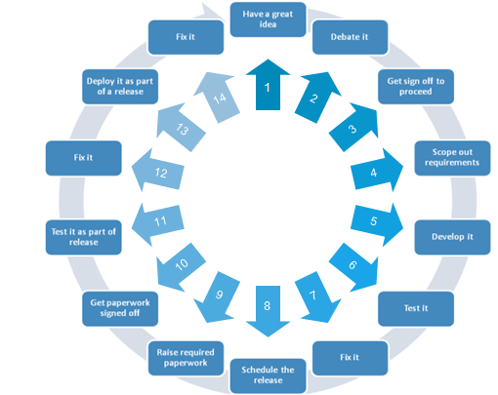
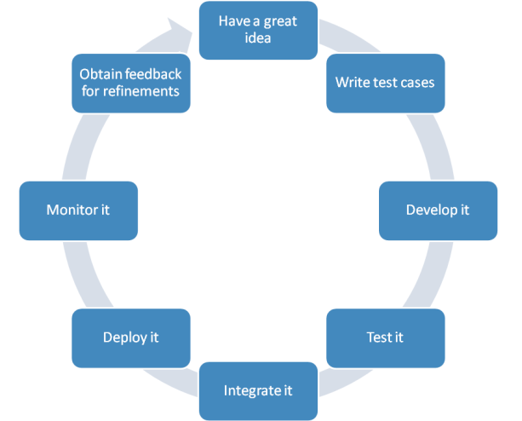
The objective is to simplify and streamline the application lifecycle management from development to operations
1
2
3
4
5
6
7
8

Slide 6
We have chosen this approach due to the multiple benefits it brings to SOK in terms of improved quality…
Area
Benefits
Improved Quality
Easy and faster access to new features and business functionalities: capability to meet the constantly changing business requirements
Higher end-to-end availability and successful days at business processes due to:
Less disruptive upgrades
Less hand-overs within release deployments
Automated provisioning
Automated testing
Automated deployments
Better change management in the whole environment
Improved security.
Flexibility and Agility
Lower Lifecycle Costs

Slide 7
… in terms of increased flexibility and agility throughout the pipeline…
Area
Benefits
Improved Quality
Faster time-to-market of solutions that meet changing business needs due to:
Built-in flexibility when moving from Waterfall IT to Agile IT
Acceptance of changes in smaller, granular and manageable portions
Shorter development-to-production lifecycle
Increased automation level in
Continuous integration
Testing
Continuous deployment
Infrastructure provisioning
Improved capability to cope with changes in Topsi application landscape
For example support Topsi landscape SATO transitions.
Flexibility and Agility
Lower Lifecycle Costs

Slide 8
…and remarkable overall cost savings
Area
Benefits
Improved Quality
Significantly lower development costs due to
Simplified and agile sw-development process (e.g. case Fosteri)
Efficient use of offshoring also in development
Less manual work in all phases due to increased automation
Lower infrastructure costs due to dynamic, scalable capacity and resource scaling
Lower license costs due to use of SaaS and Open-Source Software tools
Less effort spent on wasteful deliveries due to stable and predictable releases.
Flexibility and Agility
Lower Lifecycle Costs

Slide 9
Why this approach?
Application lifecycle management
One cross functional team
Critical success factors
References

Slide 10
Efficiently managed application lifecycle in SOK’s complex environment
One team
No silos between
Dev, Ops, Infra
and Testing
Agility
Build-Release- Run-Repeat
Automation
Integrated toolsets and service virtualization
Means: Combined AD/AM/IS team that takes care of all SOK Kemy systems
Means: Agile development and continuous deployment packed with dynamic capacity
Means: Automation everywhere supported by PaaS, IaaS and Best of Breed solution

Slide 11
Agile principles support application life cycle management
Minimum viable product -thinking

Slide 12

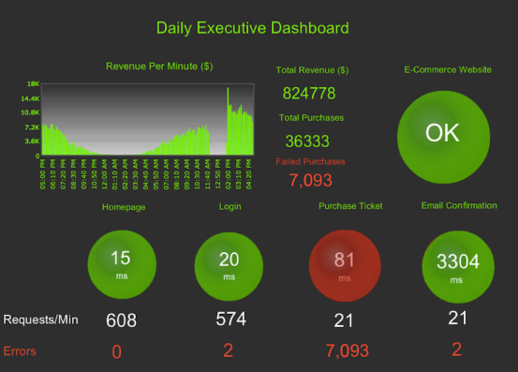

The application lifecycle from business to operations
Minna
Cost Saving
Minimum viable product
Right time
Rapid time to value
Business Development Testing Operations
From silos to one pipeline

Slide 13


Continous Delivery Technology model
Emma/ Seetesh
Real-time application performance monitoring throughout application lifecycle
AppDynamics New Relic
Node
Node
Node
DATA DRIVEN
CHANGE !!!!
Node
Node
Node
Feedback /
Metrics,
Real Data on End User Experience
Node
Node
Node
Node
Node
Node
Puppet/Ansible
Puppet/Ansible
Puppet/Ansible
DEV/
SYST
UAT
PRE-PROD
PROD
Feature
Branch
Self Service Configuration, Server provisioning automation and virtualization
Update SIT Puppetmaster to latest VCS
Revision and run Puppet on all nodes
Update UAT Puppetmaster to latest VCS
revision and run Puppet on all nodes
Update Pre-Prod Puppetmaster to latest VCS
revision and run Puppet on all nodes
Continuous Build and Deployment
Open Pull
Request
Post
commit hook
(HTTP request)
Unstable / Develop
Branch for release
Release – 1.0
Release sign-off
Promote release
Release – 1.0
Merge
Pull Request
GIT / SVN

Slide 14
Continuous Build and Deployment....
Emma/ Seetesh/Niraj
Purpose
xxxx
Key activites
Build (Maven or Ant)
Continuous integration (Jenkins)
Deploy (Scripts in Jenkins)
Package
Repository (GIT or SVN)
Automated release management (uDeploy)
Capgemini tools:

Slide 15
Server automation and Virtualization
Saki
Purpose
xxxx
Key activites
Configuration?
Capacity
Automated provisioning
VMWare
VirtualBox
Vagrant
Capgemini tools:

Slide 16
Test automation
Juha
Purpose
xxxx
Key activites
Incremental testing (Selenium or HP QC or QTP)
Xxxxx
Xxxxx
Xxxxx
Capgemini tools:

Slide 17
Application Performance Monitoring
Emma
Purpose
xxxx
Key activites
Analyze
Alerts
AppDynamics
New Relic
Nagios
Capgemini tools:

Slide 18
Code Review
Emma
Purpose
xxxx
Key activites
Xxxxx
Xxxxx
CAST
SonarQube
Checkstyle
Capgemini tools:

Slide 19
Why this approach?
Application lifecycle management
One cross functional team
Critical success factors
References

Slide 20
One cross-functional team is responsible for the application product end-to-end
Emma
Traditional silos are destroyed and everybody has access to same dashboards and tools
Instead of each team focusing separately either on coding, testing or deploying everybody focuses on the product itself and strives for common goal
New approach improves efficiency and knowledge sharing
It tightly integrates business, development and operations to drive agility and delivery excellence across the entire lifecycle
Notes:
siloed teams, each with differing motivations and areas of focus doesn’t deliver consistency.
Common goals, tools and processes
Team is empowered to self-sufficient as they can code, test and deploy

Slide 21
Certain roles are vital for successful implementation of agile methods throughout application lifecycle
Emma
Automation Architect analyze, design, and implement automation strategies
Release Manager oversees coordination and integration of development, testing and deployment tasks to support continuous delivery
Experience Assurance Professional ensures that all new features and functions are released with intended end user experience
Technical specialists takes care of both development and operational tasks and testing
Product Owner is responsible for the product success and value creation
SCRUM Master is responsible for the success of agile processes
Microservice and Service Virtualization Architect defines and designs microservices and service virtualization
Utility Professional operates across development platforms, tools, networks, servers and databases to ensure quality and resource management are taken care of
Security Engineer works side by side with developers to ensure security issues are taken into account early in the process

Slide 22
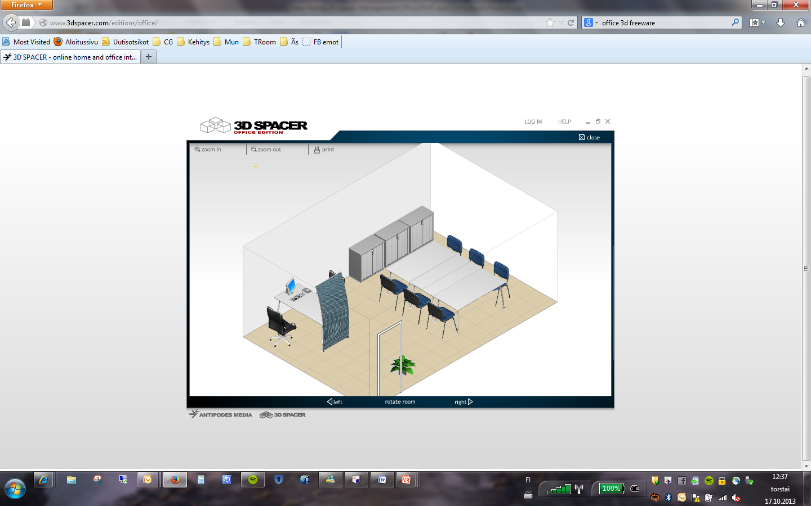
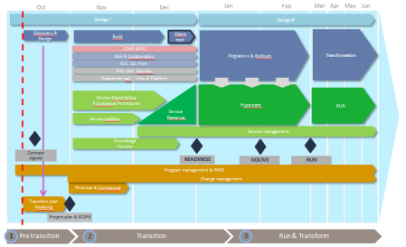


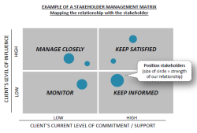
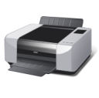
One team works efficiently cross border using war room
Emma
HIGH
Impact
LOW
LOW
Likelihood
HIGH

Slide 23
Why this approach?
Application lifecycle management
One cross functional team
Critical success factors
References

Slide 24
Critical success factors in Dev Ops transformation / “Must Fix”
SaaS tools
Dynamic capacity
Automated testing
APM???
Automated security testing
Static code analysis

Slide 25
Why this approach?
Application lifecycle management
One cross functional team
Critical success factors
References

Slide 26
This is not only theoretical approach, this is real life

Slide 27
Case RMG, Thales, Coke
Seetesh

Slide 28
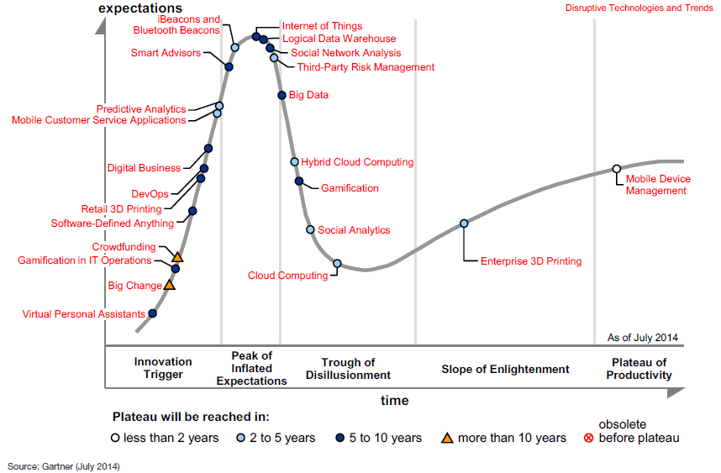
In Gartner’s latest Hype Cycle for Enterprice Architecture DevOps is positioned in the innovation Trigger phase
Heli

Slide 29
Capgemini has wide experience in agile application lifecycle management
Seetesh
Include Philips refefrence list
Picuture of logos

